Slide 1
Searching for Federal Funding
Notes:
Welcome to this module focused on searching for federal grant funding.

Slide 2
Overview
Identify sources for federal funding
Strategies for finding relevant funding
Notes:
After completing this module, you will be able to identify sources for identifying federal funding and will learn strategies to find funding sources and calls for applications that are most relevant to your proposed project.

Slide 3
Common Funding Sources: Grants
Listing of common sources
http://research.ouhsc.edu/grants/funding-sources/
PIVOT database
http://pivot.cos.com/funding_main
NIH announcements
http://grants.nih.gov/grants/guide/index.html
Notes:
This site includes three useful links to identify funding sources.

Slide 4
OUHSC Listing
http://research.ouhsc.edu/grants/funding-sources/
Notes:
The first is a list that is maintained by the OUHSC Vice President for Research office. This list includes grant funding mechanisms that are offered at a local, regional, and national level. This is a good place to start if you are interested in first finding funding for small pilot projects and then building on this information to submit grants to regional agencies, and then ultimately, federal agencies.

Slide 5
PIVOT Database
http://pivot.cos.com/funding_main
Advanced search criteria to focus the funding search
View the tutorial that is available on the main page
Notes:
A useful search engine for funding is available at the PIVOT site.
This site provides many advanced criteria for performing your search so that you are able to find grant funding mechanisms that relate specifically to your content areas, as well as criteria such as funding amount, due dates, and restrictions such as citizenship requirements.
There is a useful tutorial that is available on this main page. View the tutorial to learn more about the advanced search options.

Slide 6
NIH Funding Mechanisms
http://grants.nih.gov/grants/guide/index.html
Notes:
This site provides a search of NIH funding mechanisms. Begin by entering terms into the search box and then refine the search by using Boolean operators or setting other restrictions.

Slide 7
Example Search
Identify funding to support secondary data analysis of diabetes-related complications
Key Words: diabetes AND secondary AND data
Caution – don’t be too specific in your search terms
Notes:
Let’s consider an example in which we would like to find funding mechanisms to support secondary analysis of existing data. We are interested in using existing data sources to identify factors associated with vascular complications of diabetes.
We will use three key words, “diabetes”, “secondary”, and “data”. These words can be in any order in the abstract of the call for applications. We don’t want the search to be too narrow and therefore, will not include “complications” as a key word. If we find that using the three listed key words results in too many funding mechanisms, we then add additional restrictions to the search.

Slide 8
Example: NIH Sources

Slide 9
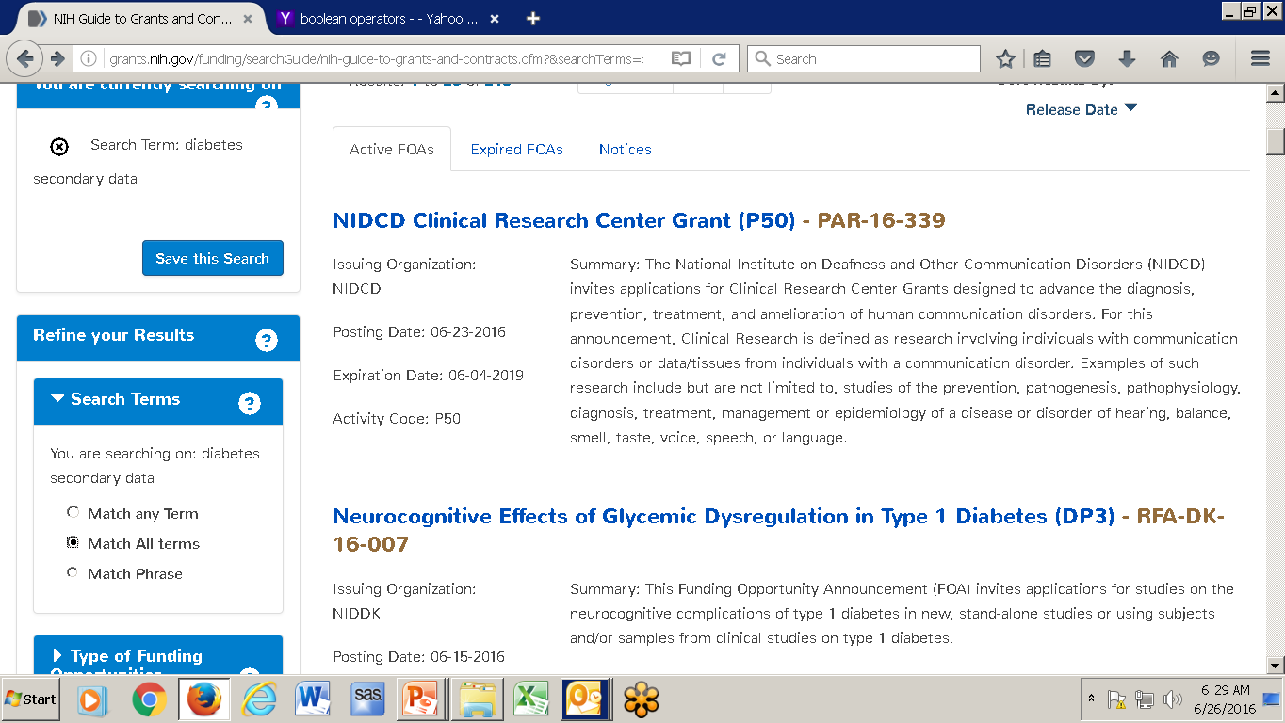
Example: NIH Results
Results: 213 announcements
Refine:
Notes:
The initial search results in 213 funding announcements. We want to include additional search terms to narrow down the number of announcements that we need to review.
We will refine the search by indicating that we want to match ALL of the key words.

Slide 10
Example NIH: Results Continued
Results: 3 relevant announcements
Limited Competition: Small Grant Program for NIDDK K01/K08/K23 Recipients (R03) - PAR-16-148
Small Grants for New Investigators to Promote Diversity in Health-Related Research (R21) - PAR-16-064
Secondary Analyses in Obesity, Diabetes and Digestive and Kidney Diseases (R21) - PA-15-169
Notes:
With the additional search criteria, we have identified three relevant announcements. The R21 seems to be the most appropriate mechanism as it is focused on secondary analyses while the other mechanisms are more general.
We would want to review the announcement for each of these mechanisms to understand the scope and relevance of each announcement.

Slide 11
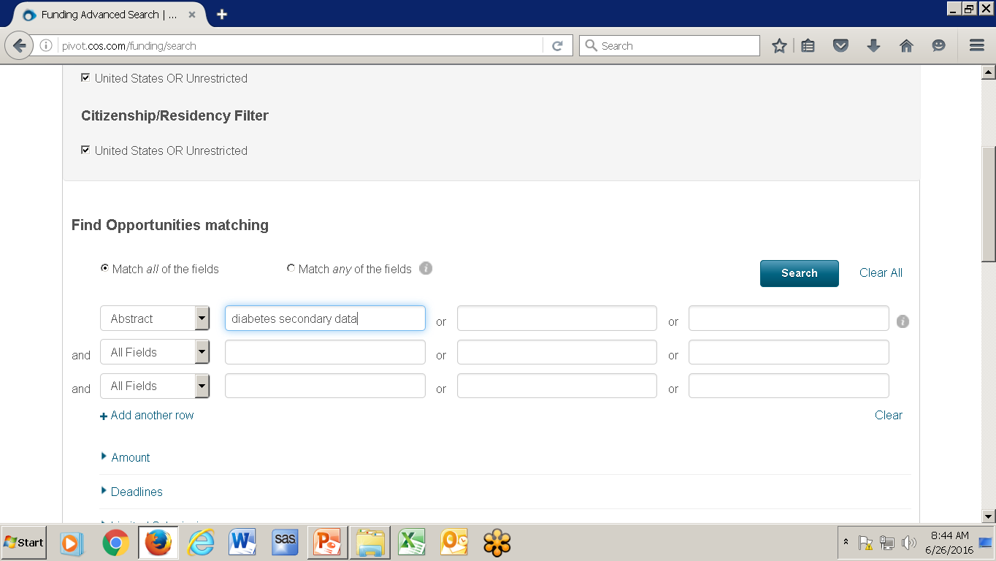
Example: PIVOT
http://pivot.cos.com/funding_main
Notes:
We will now conduct the same search using the PIVOT database. We enter our three key words in the search box indicating that we want to find these three words, in any order, in the abstract.

Slide 12
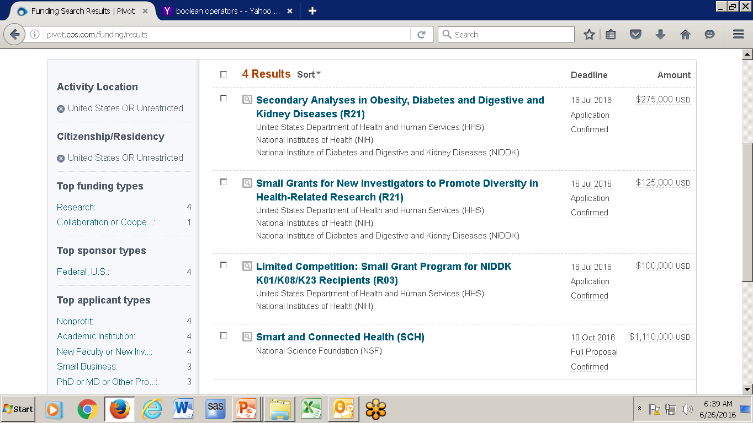
Example: PIVOT Results
Identified 4 announcements
Notes:
The PICOT database resulted in four announcements. The most relevant R21 grant was found along with one other that was also identified by the NIH search. The PIVOT search also identified a K award and an NSF call for applications.

Slide 13
Investigate Funding Announcement
Find projects that have been funded under the identified mechanism
eReporter (find related projects)
http://projectreporter.nih.gov/reporter.cfm
Notes:
We believe that the funding announcement PA-15-169 is the most relevant to our project goals. We can search the NIH funding reporter to review grants that have been funded under this mechanism. eReporter provides the abstract, investigator information and funding information for all projects that are funded through NIH. It is helpful to review this information for previously-funded applications to ensure that what we are proposing has not already been funded and that our project falls within the scope of projects that have been previously funded.

Slide 14
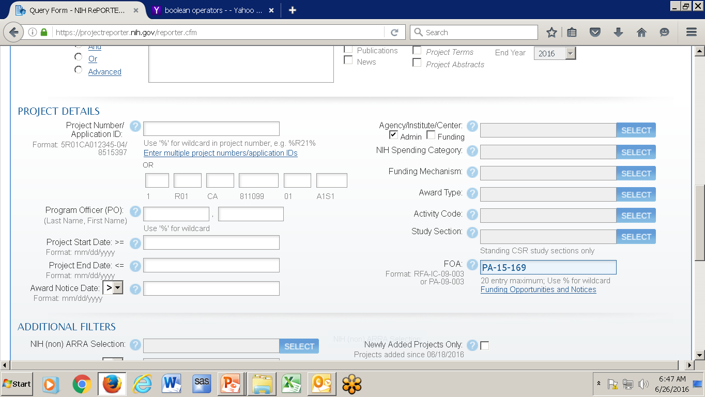
Example: eReporter
Enter announcement number and refine activity dates to include active and previous awards beginning in 2014
Notes:
In eReporter, we can enter the specific funding announcement number near the bottom of the screen. We will also want to indicate the years, near the top of the screen, and indicate that we want to review all active grants as well as those that were active beginning in 2014.

Slide 15
Example: eReporter Results
Notes:
Our search found three grants that have been funded under the mechanism of interest. We can now select these projects to learn more about the aims and scope of each project.

Slide 16
Currently-funded Projects
PA-15-169
Recently opened
Search previously-funded projects under prior version of the announcement: PA-12-125
Find 40 listings during the period 2013 – 2016.
Notes:
Note that when using eReporter to find projects funded under a particular program announcement, if the program announcement is new, you may not find many funded grants. When you are reviewing a new funding announcement, you may also want to conduct a search under the previous version of the call. For example, announcement PA-15-169 is a new issue of the previous announcement PA-12-125. So, we will want to repeat our search using the announcement code PA-12-125 to gain a better understanding of the projects that align with this announcement.
The series of announcement numbers can be found at the top of the current announcement. When we conduct a Google search for “PA-15-169”, the announcement indicates that this is a “Reissue of PA-12-125”. We can then use the previous announcement to search for funded applications in eReporter.

Slide 17
Reviewing Announcements
Identify an activity code, e.g., PA-15-169
Important sections
Dates
Funding amounts
Purpose
Objectives
Page limits
Required components
Notes:
When you have identified an announcement of interest, you will want to carefully review the announcement to determine the submission deadlines, duration and amount of funding, the purpose and objectives of the announcement, and the page limits and required components of the grant. Based on this information you can determine if this is a good fit for your project. The announcement will also include contact information for the program officer. It is always a good idea to contact the program officer to discuss the aims of your proposed project relative to the announcement to determine if the announcement is a good fit for your proposal.

Slide 18
Summary
Grant funding databases
Explore funding records to learn more
Notes:
In summary, there are several key databases that can be searched to identify relevant funding sources. In addition, the NIH database of funded applications, eReporter, is a useful resource to learn more about the types of projects that have been previously funded under the announcement of interest. Investing time in an initial search can be very helpful for identifying the most relevant funding announcements for your project.

